Slide 1


Augmented reality apps with PhoneGap
(Using the Wikitude SDK)
Andreas Schacherbauer - Head of SDK Development

Slide 2


Wikitude at a glance
v
v
Largest independent AR platform
First AR app
REFERENCES
v

Slide 3
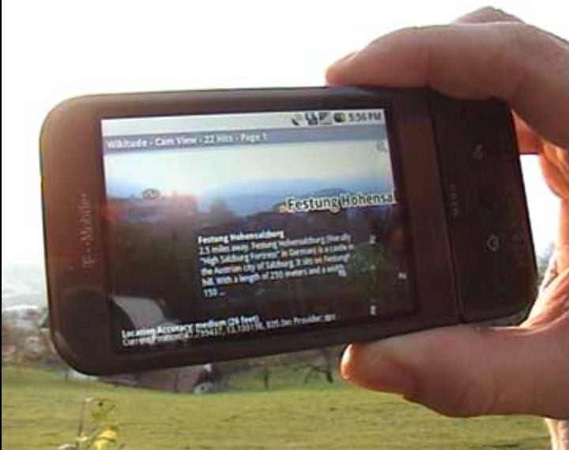
First version of Wikitude

Slide 4
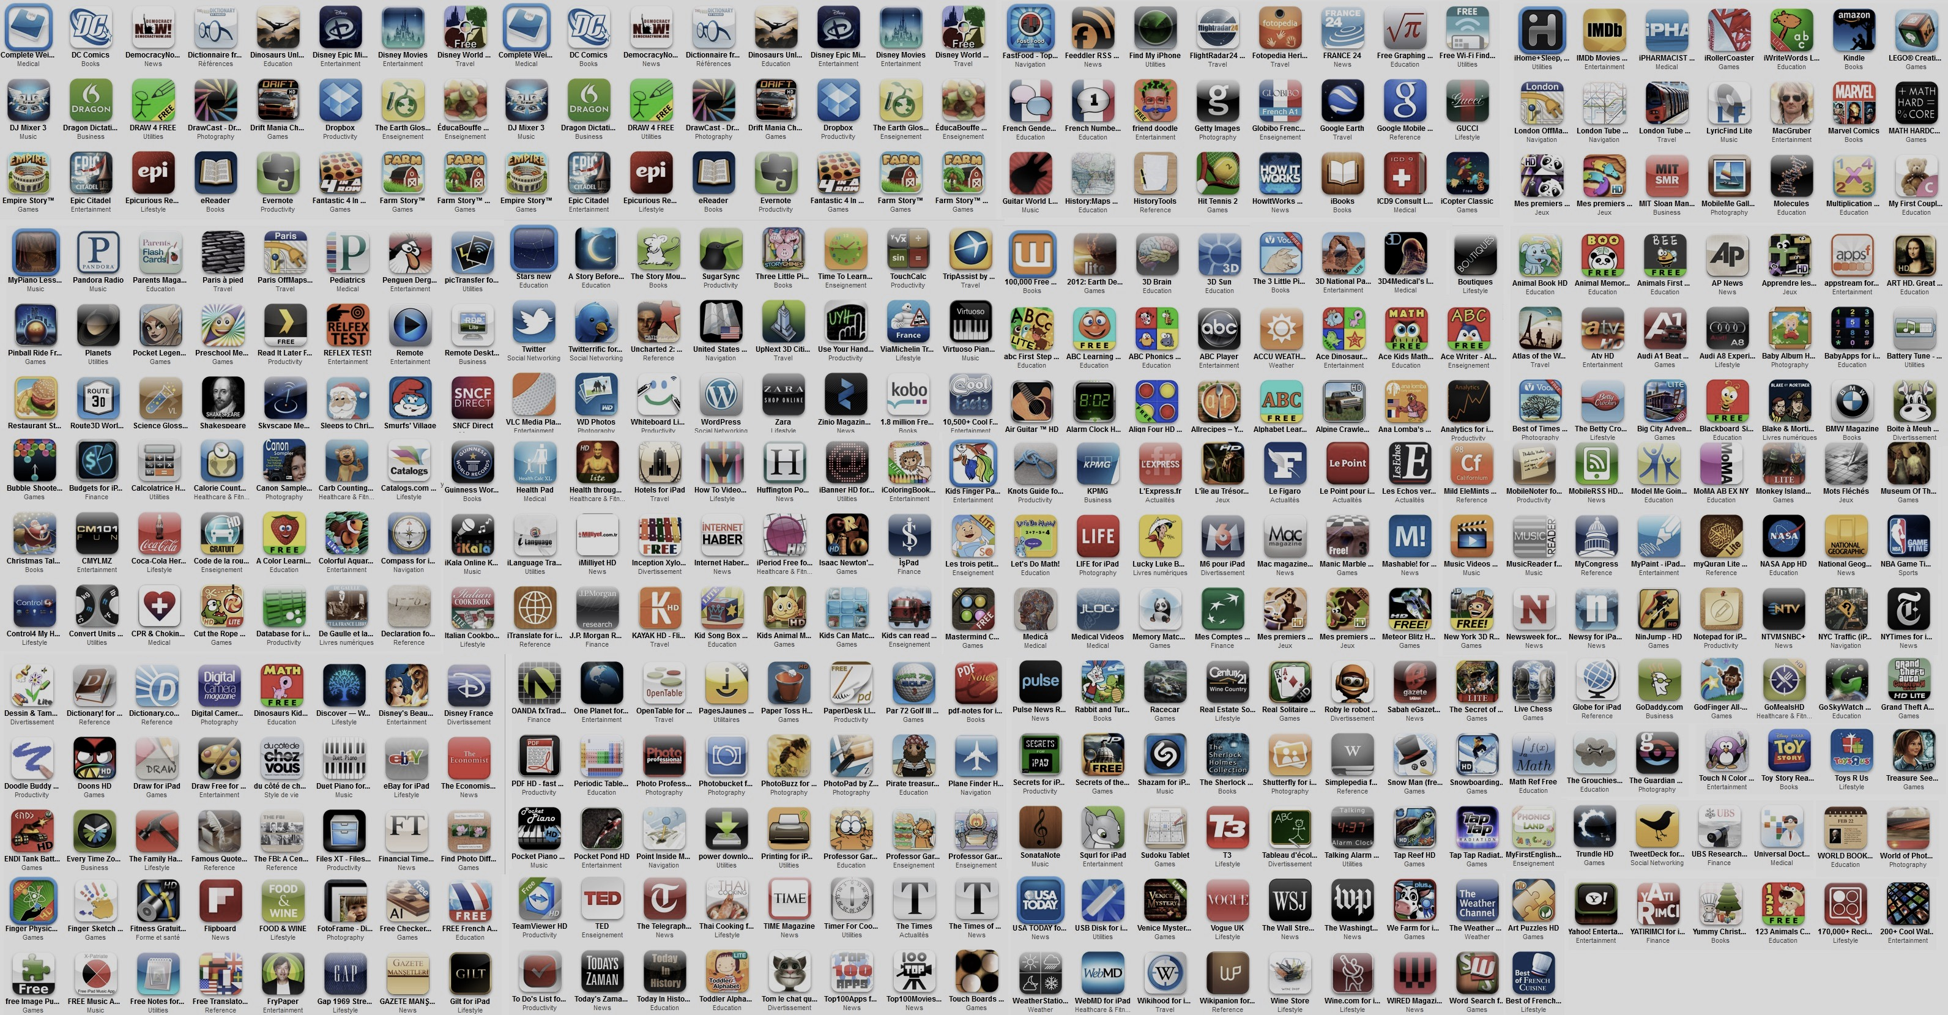

Largest independent AR platform
+10,000 apps
+100 mio app installs

Slide 5

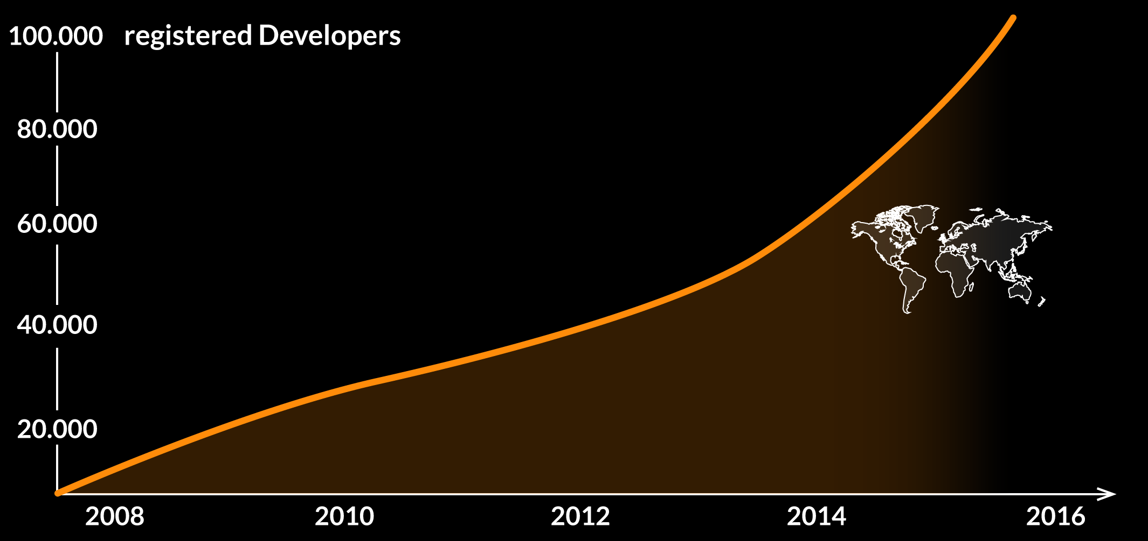

Largest independent AR platform
in 150+ countries globally

Slide 6

Largest independent AR platform
20 of the 100 Best Global Brands

Slide 7




Expanding products and technologies
Since 2008
GEO / sensor based AR

Slide 8




Expanding products and technologies
2D
Since 2012
2D Image Recognition & Tracking

Slide 9
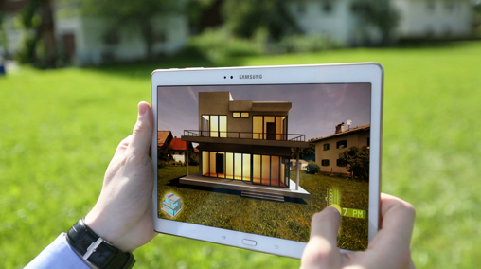
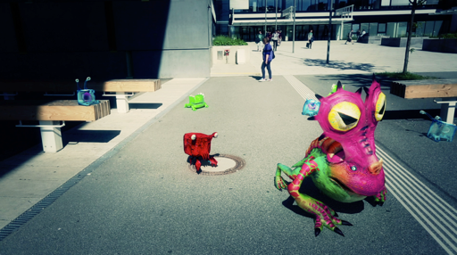
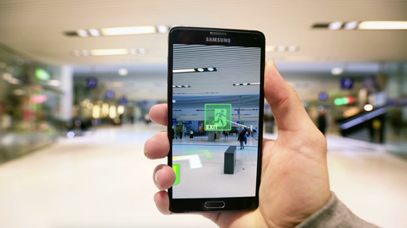
Expanding products and technologies
Since 2015
3D Tracking / SLAM
3D
architecture, real estate
gaming, filming industry
indoor navigation, retail

Slide 10
Expanding products and technologies
https://www.youtube.com/watch?v=wJmeAH4Q7SY
https://www.youtube.com/watch?v=77SVP8sPYEc

Slide 11








More choices to build your AR app
Android
iOS
Native API
Javascript API
unity
Apache Cordova
Xamarin
appcelarator

Slide 12
Wikitude JS SDK architecture (5.0)
Your App
Your App
Your App
Cordova
Titanium
Xamarin
Your App
Cordova Plugin
Titanium Module
Xamarin Component
Wikitude JavaScript API
3rd party plugin OCR
Client/Cloud Tracker
GeoObjects
Context
Radar
Drawables
…
iOS/Android Layer
Wikitude Plugin Interface
Camera
Gyro
Compass
OpenGL ES 2
C++ Layer
OpenGL ES 2 Rendering
3D Reco & Tracking
2D On-Device
Reco & Tracking
2D Cloud Reco
Plugin Manager

Slide 13
Architect world
Architect Worlds consist of:
.html file(s)
.js file(s)
.css file(s)
Defines your augmented reality experience
Use the Wikitude JS API provided within the Architect view context
<script src=“architect://architect.js"></script>
Loaded by the Wikitude SDKs Architect view

Slide 14
Architect world
Javascript execution triggers actions in the underlying C++ layer

Slide 15


Architect view composition
OpenGL ES 2 view
Renders camera stream
Renders augmentations
Web view
Loads main .html file
Transparent background

Slide 16
Wikitude Cordova Plugin
Standard Cordova plugin
Available on GitHub
Presents a new view controller on iOS and a view on Android
Integrated in the PhoneGap Developer app since version 1.7.0

Slide 17


Wikitude Cordova Plugin
Cordova web view
Wikitude Architect view

Slide 18
Wikitude Cordova Plugin
Cordova web view
Wikitude Architect view
.setOnUrlInvokeCallback(myCallbackFunction)
.callJavaScript(“/*your code*/”)
document.location = ‘architectsdk://...'
myCallbackFunction(url) is called

Slide 19
Wikitude Cordova Plugin
Demo - Cordova < - > Wikitude interaction

Slide 20
Types of augmentations
Augmentations are represented by AR.Drawable subclasses
Images - AR.ImageResource / AR.ImageDrawable
Videos (also with alpha channel) - AR.VideoDrawable
3D models - AR.Model
Web views - AR.HTMLDrawable
Labels - AR.Label

Slide 21
Geo AR
How to define e.g. a point of interest (POI)
Define where the augmentation is placed by creating AR.GeoLocations (latitude/longitude coordinates)
Define the augmentation by creating AR.Drawables
Combine location and drawables using AR.GeoObjects
POI A
Poi B
POI C
POI A
= The same geo object is displayed at different locations

Slide 22
Geo AR
Demo - POI at location
(Example on GitHub)

Slide 23
2D image recognition & tracking
How to define a 2D image augmentation
Tracker
.wtc
Define your target images by creating a target collection (.wtc file)
Create AR.Tracker objects to load target collections (.wtc file)
Define the augmentation by creating AR.Drawables
Create AR.Trackable2DObjects to define which augmentation should be shown for which target image
Trackable
References image A
Trackable
References image B
Trackable
References image C

Slide 24
2D image recognition & tracking
Demo - Target Manager and image on target
(Example on GitHub)

Slide 25
Happy Coding!
Computer vision: Augment different paintings
Geo: Place POI’s at the PhoneGap day conference locations

Slide 26
Happy Coding!
Create a .html & .js file (.css is optional at the beginning)
Add the files to your project
Load the Architect World (refer to WikitudePlugin.js)
In your .js file, use the Wikitude JS API to define your ar experience
http://www.wikitude.com/documentation/
https://github.com/Wikitude/wikitude-cordova-plugin-samples/tree/master/SampleAppResources/world

Slide 27

Thank you!
Email: andreas.schacherbauer@wikitude.com
Twitter: @a_schacherbauer

